Slide 1
Instaplace
Going online for the best of offline experiences

Slide 2

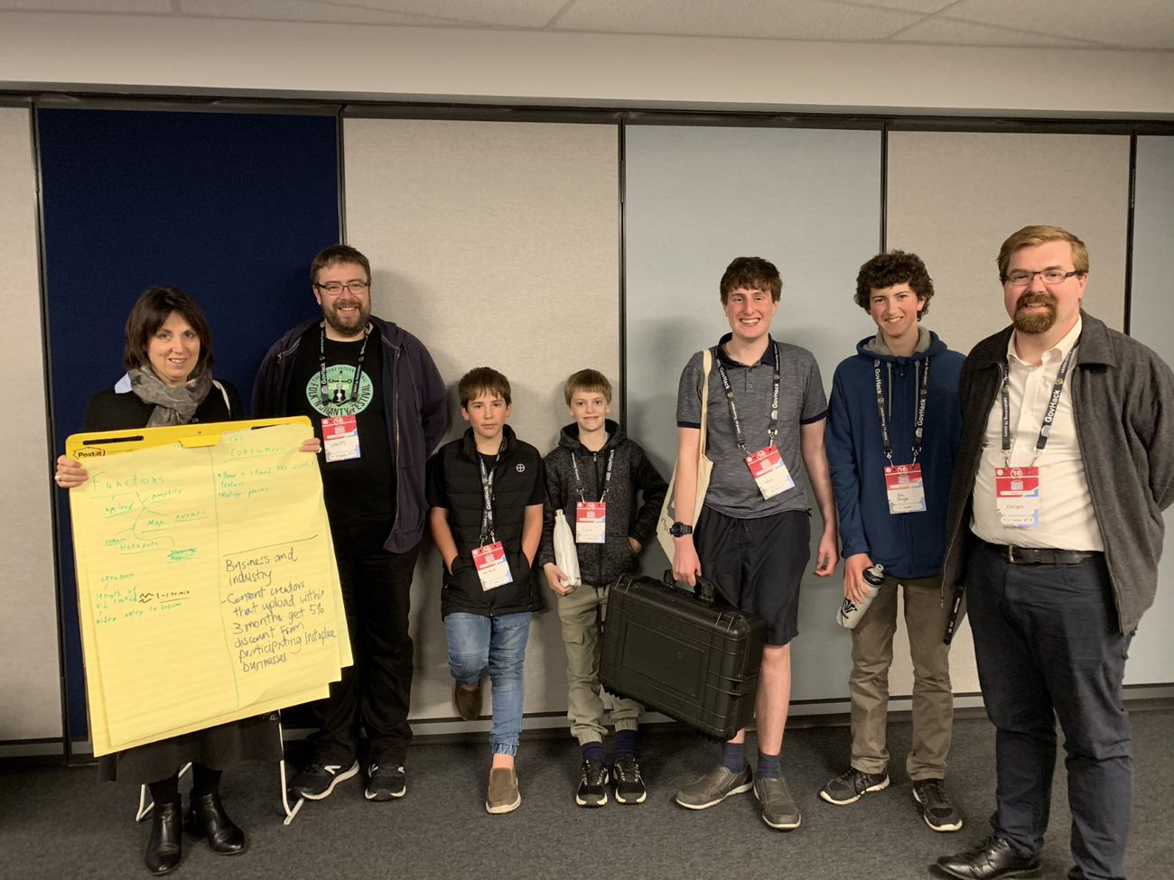
Meet our team We are the Great Southern Grammar Govhackers. We are a group of students and staff working to make our city a great place to live, through our conceptual platform InstaPlace.
Team leader/
Data cruncher
Front end hacker
Media man
Research support/
Ideas woman
Master coder
Content creator
creativity

Slide 3
Our chosen Challenges
Why is “place making” important for local communities?
There’s nothing for us here!
Public transport for the future
Thrive or survive: how can we be ready for the future
Increased participation for plastic free July
Encouraging participation of WA youth in the broader community
Most creative use of data in WA

Slide 4
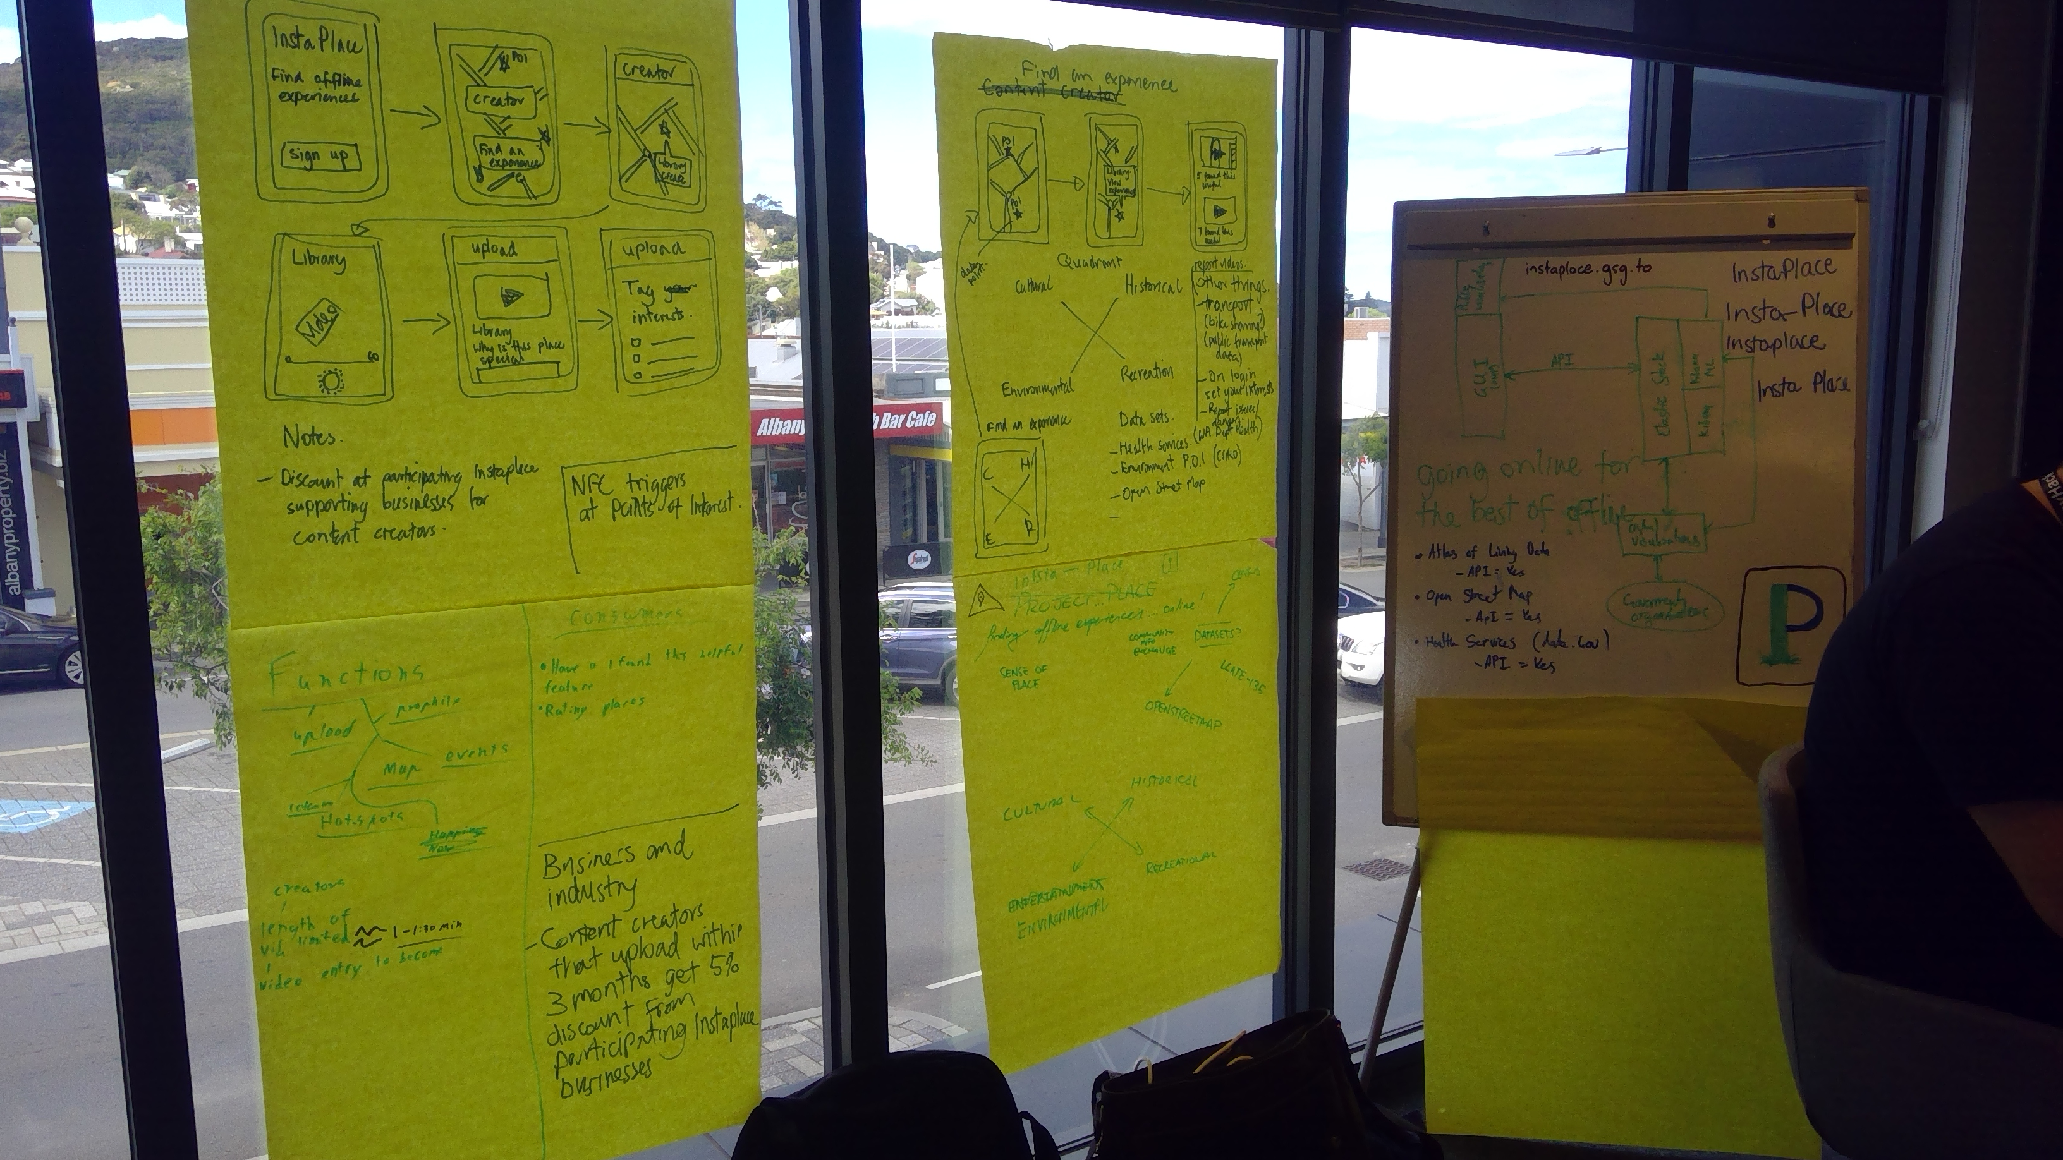
OUR MAIN IDEA CAME FROM OUR INITIAL CHALLENGE: Why is “placemaking” important for local communities? We began to brainstorm…………..

Slide 5
Purpose of Our app:
“Sense of place” is the fundamental way in which young people understand who they are.
The region in which someone grows up, the places they visit, and the relationships they form are crucial in this process.
InstaPlace provides young people with a way to become content creators for their local town, identifying places that resonate with them and why they are significant in their lives.

Slide 6
Purpose of our app:
InstaPlace will drive economic opportunities for small business in the region by encouraging them to join as an InstaPlace Supporter.
Content Creators are incentivised to upload videos frequently to maintain access to in-store discounts from those InstaPlace Supporter small businesses.
Consumers will find great places to spend their offline time.
Provide mental health benefits of engaging in offline experiences.
Small businesses who are InstaPlace Supporters must demonstrate environmental responsibility to join.

Slide 7
Consumers
The platform doesn't use a comment or video rating system, but uses an 'I found this helpful' option to support positive posting of Experience Videos.
Consumers fill out a survey to express their interests.
No comment section to avoid negativity.
Get recommended activities/videos by viewing uploaded offline experiences.

Slide 8
producers
Upload videos limited to 90 seconds.
Need to submit a video to become a creator.
Creators get a 5% discount from local business that are InstaPlace supporters who meet our sustainability criteria when they have uploaded a video within the last month.
N.B. Young people have a desire to be useful. By empowering our youth to become content creators, InstaPlace will drive belonging, and a moral desire to become environmentally sustainable stewards for their 'places’.

Slide 9
How it works
Consumers will log on and be met with a survey that will show their interests. This will affect what shows up when they open the map showing creators videos and interests.
If a consumer finds a video particularly helpful they can leave a helpful mark. When an app consumer sees this mark, they can see that it was helpful for someone else.

Slide 10




QUADRANT OF EXPERIENCES:
InstaPlace focuses on a quadrant of experiences for young people.
Cultural
Environmental
Historical
Recreational

Slide 11
GSG GOVHACKERs chosen Data Sets:
OpenStreetMaps to create a platform where young people can upload Experience Videos from key locations around their city.
Cultural experiences by using Heritage Council of Western Australia Aboriginal Heritage Places data.
Environmental data is sourced from CSIRO with a focus on the dataset 'Atlas of the Living' which allows users to develop a sense of place connected to the environment.
Department of Transport transportation routes recognises the need for viable transportation options that are easy for young people to access. Future versions of our platform will use data to facilitate bicycle-sharing at bus stops and public transport hubs.

Slide 12
GSG GOVHACKERs chosen Data Sets:
To support mental health outcomes for young people, access to Department of Health health services and establishment data as an overlay will be included. This data overlay will be displayed to all users all the time, as a prompt to driving positive mental and physical health outcomes.
Data will also be sourced from the Community Information Exchange to provide users an overview of realtime events happening in the local community. This will also allow local government to provide Events as a point of interest overlay.

Slide 13

Concepts for the future
Future versions of our platform will use data to facilitate bicycle-sharing at bus stops and public transport hubs.
A way of warning people of danger/obstacles, e.g.: swooping magpies, road work etc
Passenger Drones
Upcoming events e.g.: concerts, Albany entertainment centre
A report video system to avoid inappropriate content
An incentivisation program where a creator loads content monthly. Different rewards are gained at each tiered level.

